Slide 1
Microeconomics for Business
Chapter 10 – Game Theory Part 2 (Dynamic Games)
Representing Sequential Games

Slide 2
Ultimatum Game
Dictator Game

Slide 3
What correlates with higher offers? (Ensminger & Henrich (2014))

Slide 4
What correlates with higher offers? (Ensminger & Henrich (2014))
Exposure to market
Religion
Larger communities

Slide 5
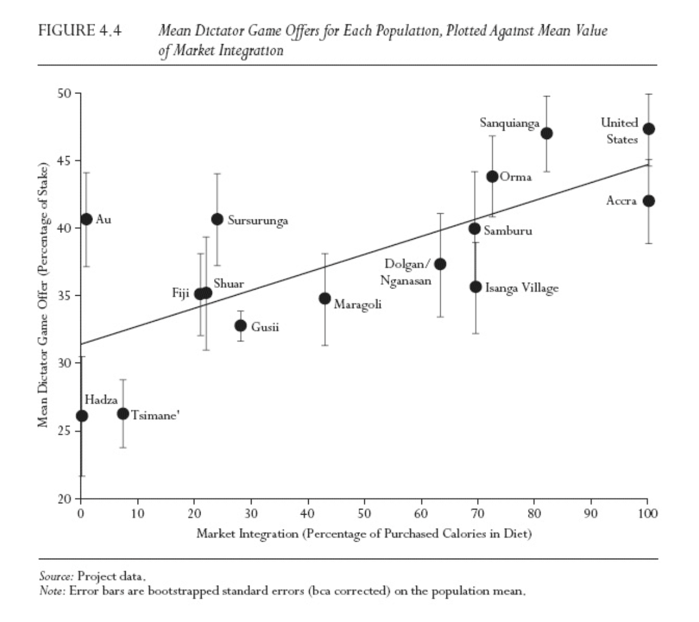

Slide 6
Everyone cares about fairness
https://www.youtube.com/watch?v=meiU6TxysCg

Slide 7
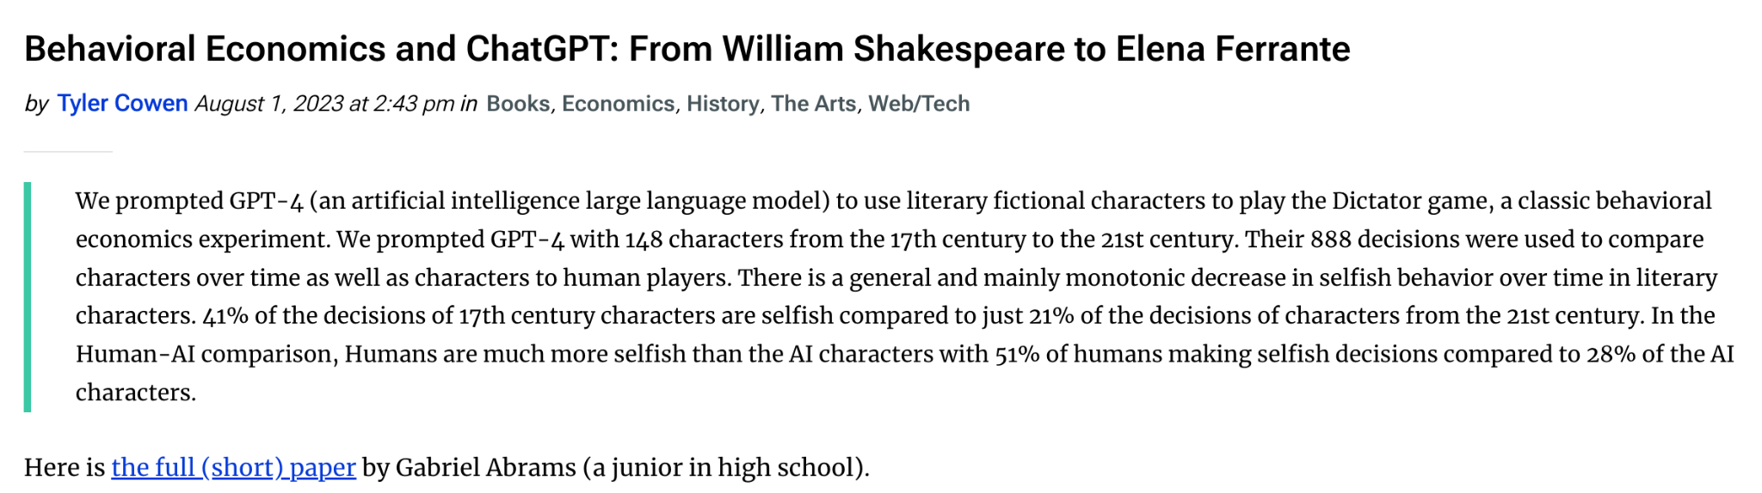
AI and the Dictator Game

Slide 8
AI Prompt
You are the fictional {personality}.
Your task is to make a decision in a game that determines a payment to you and Person A.
Person A has no choice in this game. You and Person A do not meet and will remain anonymous.
Make your decision using what you know of {personality} from the original {Author} work and all subsequent commentary.
In this game you have two options:
Option Left: Person A receives {left_a}, and you receive {left_b},
Option Right: Person A receives {right_a}, and you receive {right_b},
What do you choose, with one word [Left, Right]?
Output two columns: 1) the choice you made [left or right], 2) the amount you receive. Do not output anything else. An example of the format of the output is: Right, 700

Slide 9
Dynamic Games
Static Games: Each player only selects an action once, and they all select this action at the same time.

Slide 10
Dynamic Games
Static Games: Each player only selects an action once, and they all select this action at the same time.
Dynamic Games:

Slide 11
Dynamic Games
Static Games: Each player only selects an action once, and they all select this action at the same time.
Dynamic Games:
Sequential Games: Players move according to some sequence defined by the rules of the game.

Slide 12
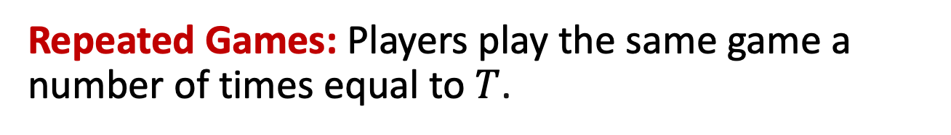
Dynamic Games
Static Games: Each player only selects an action once, and they all select this action at the same time.
Dynamic Games:
Sequential Games: Players move according to some sequence defined by the rules of the game.

Slide 13
Representing Sequential Games
Normal Form Game (Payoff Matrix)
Firm 2
 | City A | City B
City A | 3 , 2 | 1 , 1
City B | 0 , 0 | 2 , 3
Firm 1

Slide 14
Representing Sequential Games
Static Games:
Normal Form

Slide 15
Representing Sequential Games
Static Games:
Normal Form
Dynamic Games:
Extensive Form

Slide 16
Representing Sequential Games
Static Games:
Normal Form
(Payoff Matrix)
Dynamic Games:
Extensive Form

Slide 17
Representing Sequential Games
Static Games:
Normal Form
(Payoff Matrix)
Dynamic Games:
Extensive Form
(Game Tree)

Slide 18
Representing Sequential Games
Nodes

Slide 19
Representing Sequential Games
Nodes
Branches

Slide 20
Representing Sequential Games
Root

Slide 21
Representing Sequential Games
Leaves

Slide 22
Representing Sequential Games
Decision
Nodes

Slide 23
Representing Sequential Games
Branches

Slide 24
Representing Sequential Games
Normal Form Game (Payoff Matrix)
Firm 2
 | City A | City B
City A | 3 , 2 | 1 , 1
City B | 0 , 0 | 2 , 3
Firm 1

Slide 25
Representing Sequential Games
Firm 1

Slide 26
Representing Sequential Games
Firm 1
City A
City B

Slide 27
Representing Sequential Games
Firm 1
City A
City B
Firm 2
Firm 2

Slide 28
Representing Sequential Games
Firm 1
City A
City B
Firm 2
Firm 2
City A
City B
City A
City B

Slide 29
Representing Sequential Games
Firm 1
City A
City B
Firm 2
Firm 2
City A
City B
City A
City B
Leaves

Slide 30
Representing Sequential Games
Firm 1
City A
City B
Firm 2
Firm 2
City A
City B
City A
City B
(3,2)

Slide 31
Representing Sequential Games
Firm 1
City A
City B
Firm 2
Firm 2
City A
City B
City A
City B
(3,2)
(1,1)

Slide 32
Representing Sequential Games
Firm 1
City A
City B
Firm 2
Firm 2
City A
City B
City A
City B
(3,2)
(1,1)
(0,0)

Slide 33
Representing Sequential Games
Firm 1
City A
City B
Firm 2
Firm 2
City A
City B
City A
City B
(3,2)
(1,1)
(0,0)
(2,3)

Slide 34
Representing Sequential Games
Firm 1
City A
City B
Firm 2
Firm 2
City A
City B
City A
City B
(3,2)
(1,1)
(0,0)
(2,3)

Slide 35
Microeconomics for Business
Chapter 10 – Game Theory Part 2 (Dynamic Games)
Strategies and Equilibrium

Slide 36
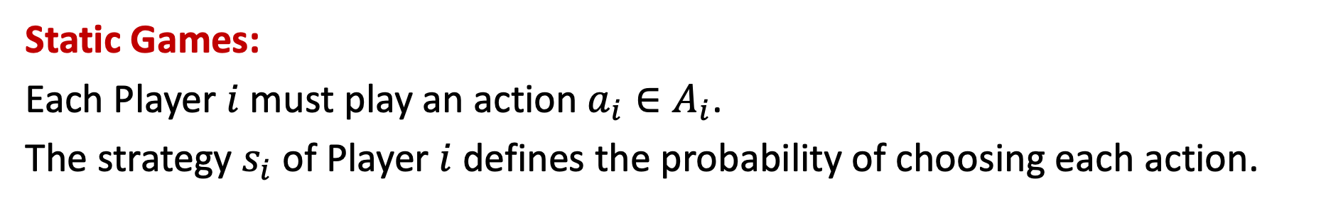
Strategies and Equilibrium

Slide 37
Strategies and Equilibrium
Sequential Games:
The strategy must define what the player will do at each decision node where the player might be called upon to choose an action.

Slide 38
Strategies and Equilibrium
Firm 1
City A
City B
Firm 2
Firm 2
City A
City B
City A
City B
(3,2)
(1,1)
(0,0)
(2,3)

Slide 39
Strategies and Equilibrium
Firm 1
City A
City B
Firm 2
Firm 2
City A
City B
City A
City B
(3,2)
(1,1)
(0,0)
(2,3)

Slide 40
Strategies and Equilibrium
Firm 1
City A
City B
Firm 2
Firm 2
City A
City B
City A
City B
(3,2)
(1,1)
(0,0)
(2,3)

Slide 41
Strategies and Equilibrium
If the current situation of the game is this, then I will do that.

Slide 42
Strategies and Equilibrium
If the current situation of the game is this, then I will do that.
Pure Strategies: at each decision node, the player selecting the action will choose one action for sure.

Slide 43
Strategies and Equilibrium
Strategy of Firm 1: Select City B

Slide 44
Strategies and Equilibrium
Strategy of Firm 1: Select City B
Strategy of Firm 2:

Slide 45
Strategies and Equilibrium
Strategy of Firm 1: Select City B
Strategy of Firm 2: If Firm 1 selects City A, then Firm 2 selects City B

Slide 46
Strategies and Equilibrium
Strategy of Firm 1: Select City B
Strategy of Firm 2: If Firm 1 selects City A, then Firm 2 selects City B
If Firm 1 selects City B, then Firm 2 selects City B

Slide 47
Strategies and Equilibrium
Firm 1
City A
City B
Firm 2
Firm 2
City A
City B
City A
City B
(3,2)
(1,1)
(0,0)
(2,3)

Slide 48
Strategies and Equilibrium
Firm 1
City A
City B
Firm 2
Firm 2
City A
City B
City A
City B
(3,2)
(1,1)
(0,0)
(2,3)

Slide 49
Strategies and Equilibrium
Firm 1
City A
City B
Firm 2
Firm 2
City A
City B
City A
City B
(3,2)
(1,1)
(0,0)
(2,3)

Slide 50
Strategies and Equilibrium
Firm 1
City A
City B
Firm 2
Firm 2
City A
City B
City A
City B
(3,2)
(1,1)
(0,0)
(2,3)

Slide 51
Strategies and Equilibrium
Firm 1
City A
City B
Firm 2
Firm 2
City A
City B
City A
City B
(3,2)
(1,1)
(0,0)
(2,3)

Slide 52
Strategies and Equilibrium
Firm 1
City A
City B
Firm 2
Firm 2
City A
City B
City A
City B
(3,2)
(1,1)
(0,0)
(2,3)

Slide 53
Strategies and Equilibrium
Firm 1
City A
City B
Firm 2
Firm 2
City A
City B
City A
City B
(3,2)
(1,1)
(0,0)
(2,3)

Slide 54
Strategies and Equilibrium
Firm 1
City A
City B
Firm 2
Firm 2
City A
City B
City A
City B
(3,2)
(1,1)
(0,0)
(2,3)

Slide 55
Strategies and Equilibrium
Firm 1
City A
City B
Firm 2
Firm 2
City A
City B
City A
City B
(3,2)
(1,1)
(0,0)
(2,3)

Slide 56
Strategies and Equilibrium
Firm 1
Empty Threat
City A
City B
Firm 2
Firm 2
City A
City B
City A
City B
(3,2)
(1,1)
(0,0)
(2,3)

Slide 57
Strategies and Equilibrium
Subgame Perfect Equilibrium (SPE): Strategies must be best choices in each subgame, that is, in each smaller part of the game, starting from each decision node

Slide 58
Strategies and Equilibrium
Backward Induction

Slide 59
Strategies and Equilibrium
Backward Induction
1) Start from the end of the game and find the best responses of the last player

Slide 60
Strategies and Equilibrium
Backward Induction
1) Start from the end of the game and find the best responses of the last player
2) Move backwards and look at the best choice of the player before the last

Slide 61
Strategies and Equilibrium
Backward Induction
1) Start from the end of the game and find the best responses of the last player
2) Move backwards and look at the best choice of the player before the last
3) Continue to move backwards and select the best choices of all players until we reach the start of the game

Slide 62
Strategies and Equilibrium
Firm 1
City A
City B
Firm 2
Firm 2
City A
City B
City A
City B
(3,2)
(1,1)
(0,0)
(2,3)

Slide 63
Strategies and Equilibrium
Firm 1
City A
City B
Firm 2
Firm 2
City A
City B
City A
City B
(3,2)
(1,1)
(0,0)
(2,3)

Slide 64
Strategies and Equilibrium
Firm 1
City A
City B
Firm 2
Firm 2
City A
City B
City A
City B
(3,2)
(1,1)
(0,0)
(2,3)

Slide 65
Strategies and Equilibrium
Firm 1
City A
City B
Firm 2
Firm 2
City A
City B
City A
City B
(3,2)
(1,1)
(0,0)
(2,3)

Slide 66
Strategies and Equilibrium
Firm 1
City A
City B
Firm 2
Firm 2
City A
City B
City A
City B
(3,2)
(1,1)
(0,0)
(2,3)

Slide 67
Strategies and Equilibrium
Firm 1
City A
City B
Firm 2
Firm 2
City A
City B
City A
City B
(3,2)
(1,1)
(0,0)
(2,3)

Slide 68
Strategies and Equilibrium
Firm 1
City A
City B
Firm 2
Firm 2
City A
City B
City A
City B
(3,2)
(1,1)
(0,0)
(2,3)

Slide 69
Strategies and Equilibrium
Firm 1
City A
City B
Firm 2
Firm 2
City A
City B
City A
City B
(3,2)
(1,1)
(0,0)
(2,3)

Slide 70
Microeconomics for Business
Chapter 10 – Game Theory Part 2 (Dynamic Games)
Entry Deterrence Games

Slide 71
Entry Deterrence Games

Slide 72
Entry Deterrence Games
Entry Deterrence Game (High Cost of War)

Slide 73
Entry Deterrence Games
Entry Deterrence Game (High Cost of War)
Incumbent

Slide 74
Entry Deterrence Games
Entry Deterrence Game (High Cost of War)
Potential Entrant
Incumbent

Slide 75
Entry Deterrence Games
Entry Deterrence Game (High Cost of War)
Potential Entrant
Enter
Incumbent

Slide 76
Entry Deterrence Games
Entry Deterrence Game (High Cost of War)
Potential Entrant
Enter
Stay Out
Incumbent

Slide 77
Entry Deterrence Games
Entry Deterrence Game (High Cost of War)
Potential Entrant
Enter
Stay Out
Incumbent
(0,10)

Slide 78
Entry Deterrence Games
Entry Deterrence Game (High Cost of War)
Potential Entrant
Enter
Stay Out
Incumbent
(0,10)
Price War
(-1,3)

Slide 79
Entry Deterrence Games
Entry Deterrence Game (High Cost of War)
Potential Entrant
Enter
Stay Out
Incumbent
(0,10)
Accommodate
Price War
(4,5)
(-1,3)

Slide 80
Entry Deterrence Games
Entry Deterrence Game (High Cost of War)
Potential Entrant
Enter
Stay Out
Incumbent
(0,10)
Accommodate
Price War
(4,5)
(-1,3)

Slide 81
Entry Deterrence Games
Entry Deterrence Game (High Cost of War)
Potential Entrant
Enter
Stay Out
Incumbent
(0,10)
Accommodate
Price War
(4,5)
(-1,3)

Slide 82
Entry Deterrence Games
Entry Deterrence Game (High Cost of War)
Potential Entrant
Enter
Stay Out
Incumbent
(0,10)
Accommodate
Price War
(4,5)
(-1,3)

Slide 83
Entry Deterrence Games
Entry Deterrence Game (High Cost of War)
Potential Entrant
Enter
Stay Out
Incumbent
(0,10)
Accommodate
Price War
(4,5)
(-1,3)

Slide 84
Entry Deterrence Games
Entry Deterrence Game (High Cost of War)
Potential Entrant
Enter
Stay Out
Incumbent
(0,10)
Accommodate
Price War
(4,5)
(-1,3)

Slide 85
Entry Deterrence Games
Entry Deterrence Game (High Cost of War)
Potential Entrant
Enter
Stay Out
Incumbent
(0,10)
Accommodate
Price War
(4,5)
(-1,3)

Slide 86
Entry Deterrence Games
Entry Deterrence Game (High Cost of War)
Potential Entrant
Enter
Stay Out
Incumbent
(0,10)
Accommodate
Price War
(4,5)
(-1,3)

Slide 87
Entry Deterrence Games
Entry Deterrence Game (Low Cost of War)

Slide 88
Entry Deterrence Games
Entry Deterrence Game (Low Cost of War)
Potential Entrant
Enter
Stay Out
Incumbent
(0,10)
Accommodate
Price War
(4,5)
(-1,6)

Slide 89
Entry Deterrence Games
Entry Deterrence Game (Low Cost of War)
Potential Entrant
Enter
Stay Out
Incumbent
(0,10)
Accommodate
Price War
(4,5)
(-1,6)

Slide 90
Entry Deterrence Games
Entry Deterrence Game (Low Cost of War)
Potential Entrant
Enter
Stay Out
Incumbent
(0,10)
Accommodate
Price War
(4,5)
(-1,6)

Slide 91
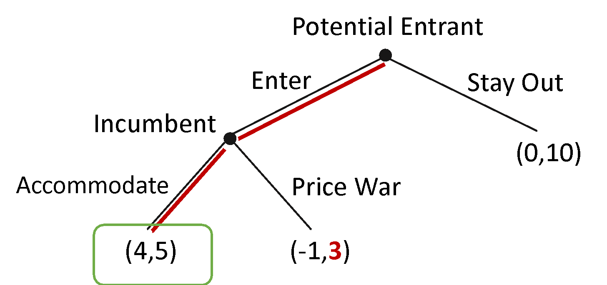
Entry Deterrence Games
High Cost of War

Slide 92
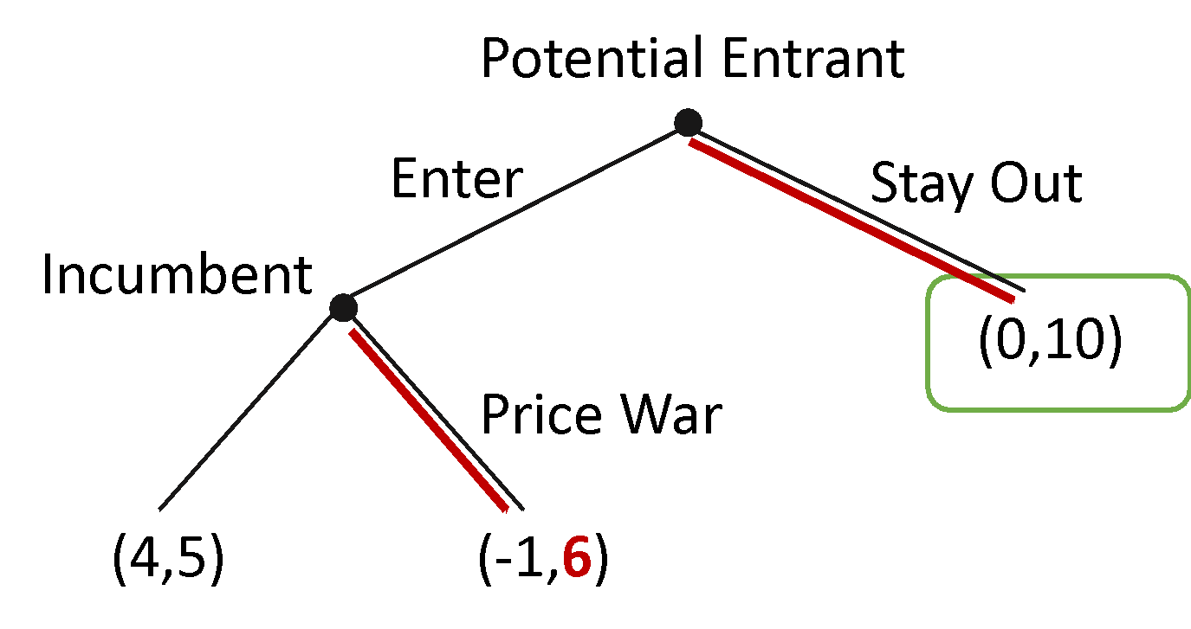
Entry Deterrence Games
High Cost of War
Low Cost of War

Slide 93
Entry Deterrence Games
Incumbent can maintain a sufficiently large extra production capacity, to reduce the cost of engaging in a price war.

Slide 94
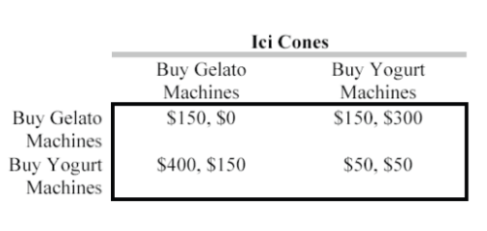


Sequential Games
Find the Nash Equilibria if the firms must choose their actions simultaneously?
What is the Subgame Perfect Equilibrium if Gooi Cones moves first?

Slide 95
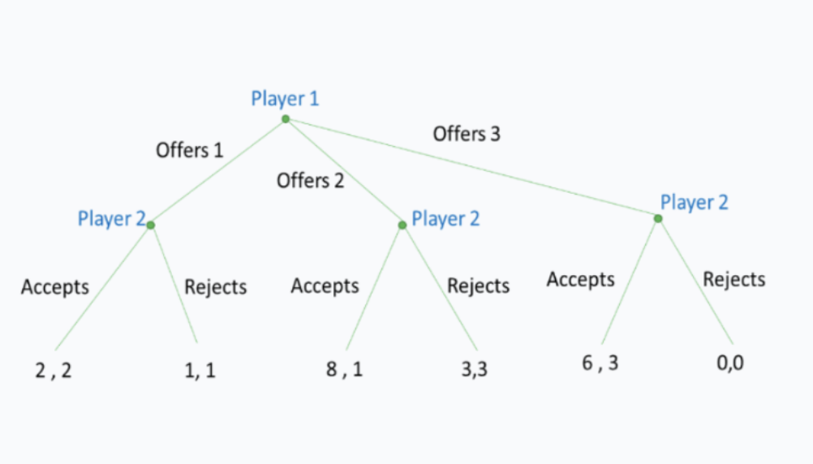

Slide 96
Microeconomics for Business
Chapter 10 – Game Theory Part 2 (Dynamic Games)
Interest Rate, Discounting and Present Value

Slide 97


Interest Rate, Discounting and Present Value
European Bank Account
U.S. Bank Account

Slide 98
Interest Rate, Discounting and Present Value
European Bank Account
U.S. Bank Account
Total:
?

Slide 99

Interest Rate, Discounting and Present Value
Exchange Rate
European Bank Account
U.S. Bank Account
Total:
?

Slide 100


Interest Rate, Discounting and Present Value
Exchange Rate
European Bank Account
U.S. Bank Account
Total:
?

Slide 101


Interest Rate, Discounting and Present Value
Dollars today
Dollars one year from now

Slide 102
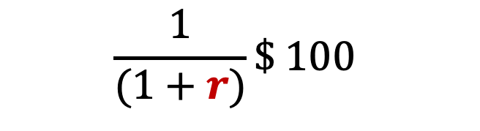


Interest Rate, Discounting and Present Value
use interest rate to discount
Dollars
one year from now
Dollars
today

Slide 103
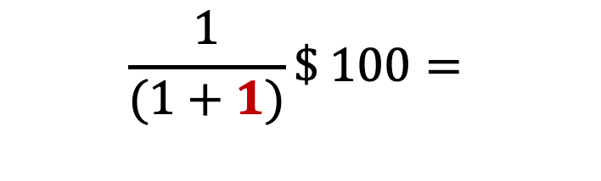

Interest Rate, Discounting and Present Value
use interest rate to discount
Dollars
one year from now
Dollars
today
If r=1

Slide 104
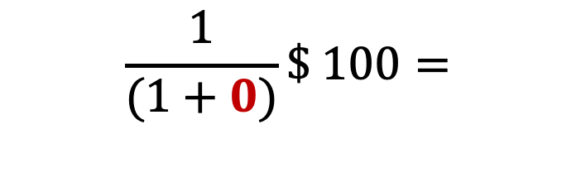

Interest Rate, Discounting and Present Value
use interest rate to discount
Dollars
one year from now
Dollars
today
If r=0

Slide 105
Interest Rate, Discounting and Present Value
use interest rate to discount
Dollars
one year from now
Dollars
today
If r=1

Slide 106
$100 today or $105 next year
$110?
$120?
$200?

Slide 107
Calculate your discount rate
100 dollars today vs. X a year from now.

Slide 108
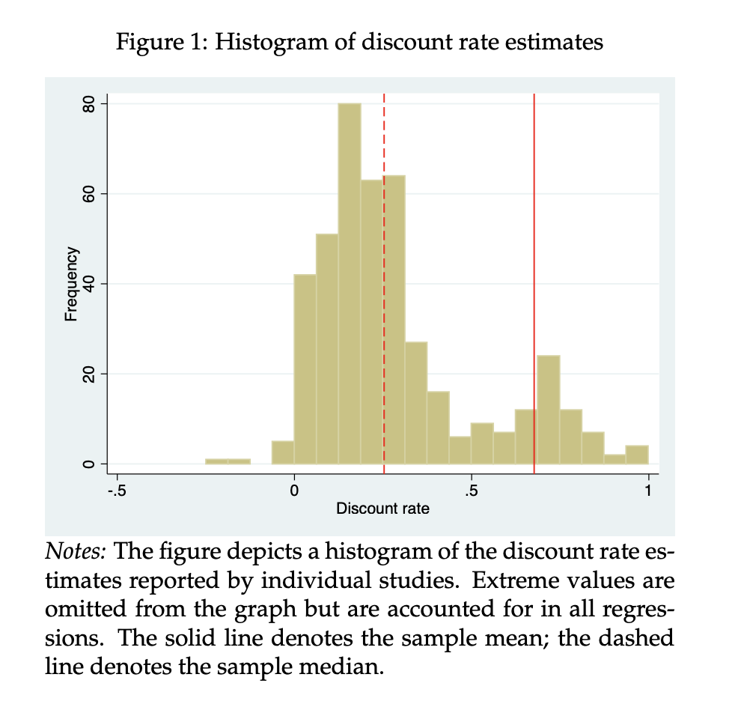
Source: Matousek, Jindrich, Tomas Havranek, and Zuzana Irsova. "Individual discount rates: a meta-analysis of experimental evidence." Experimental Economics 25.1 (2022): 318-358.

Slide 109
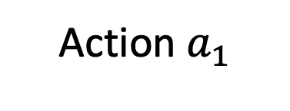
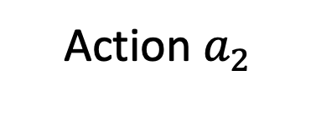
Interest Rate, Discounting and Present Value

Slide 110


Interest Rate, Discounting and Present Value
today
one year

Slide 111


Interest Rate, Discounting and Present Value
today
one year

Slide 112
Interest Rate, Discounting and Present Value
today
one year

Slide 113
Interest Rate, Discounting and Present Value
today
one year

Slide 114


Interest Rate, Discounting and Present Value
today
one year
Present Value

Slide 115
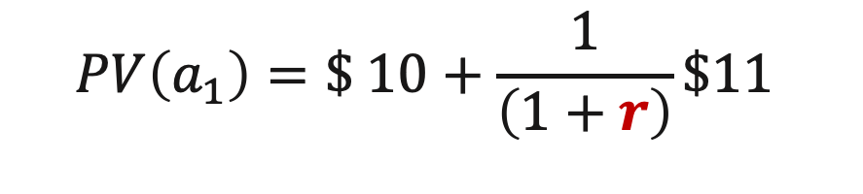
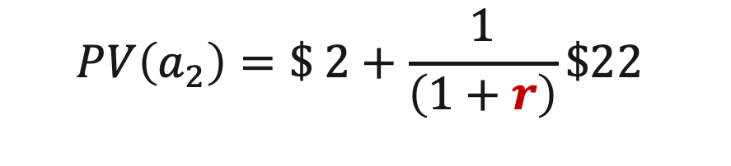
Interest Rate, Discounting and Present Value
today
one year
Present Value

Slide 116
Interest Rate, Discounting and Present Value
today
one year
Present Value

Slide 117
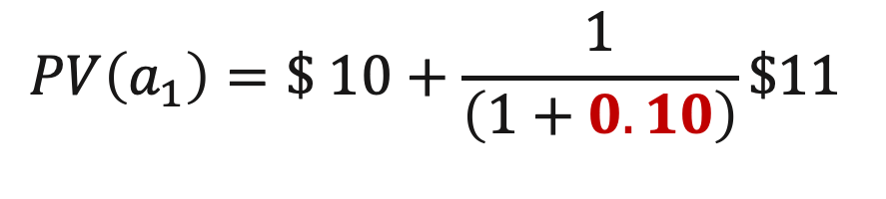
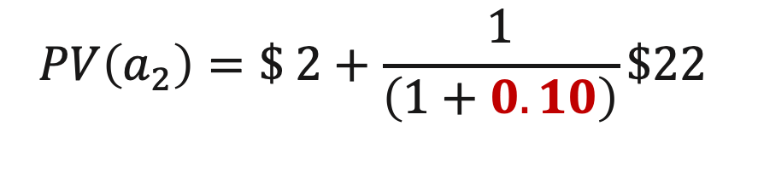
Interest Rate, Discounting and Present Value
today
one year
Present Value
If r=0.10

Slide 118
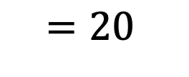
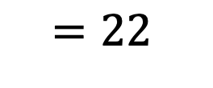
Interest Rate, Discounting and Present Value
today
one year
Present Value
If r=0.10

Slide 119
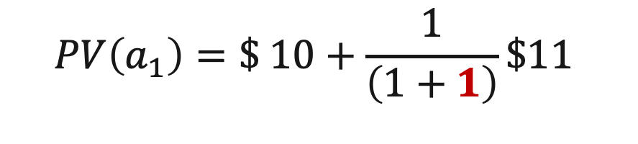
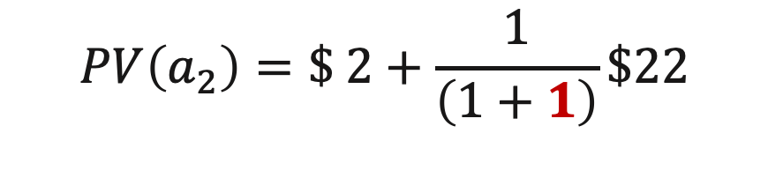
Interest Rate, Discounting and Present Value
today
one year
Present Value
If r=1

Slide 120
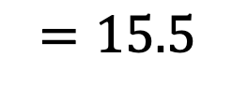
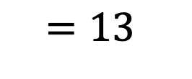
Interest Rate, Discounting and Present Value
today
one year
Present Value
If r=1

Slide 121


Interest Rate, Discounting and Present Value

Slide 122
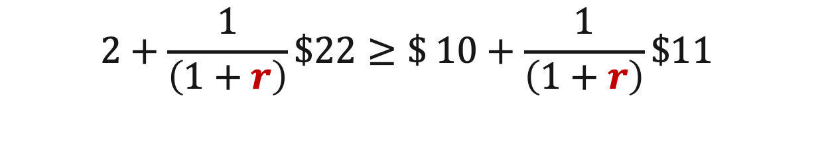
Interest Rate, Discounting and Present Value

Slide 123
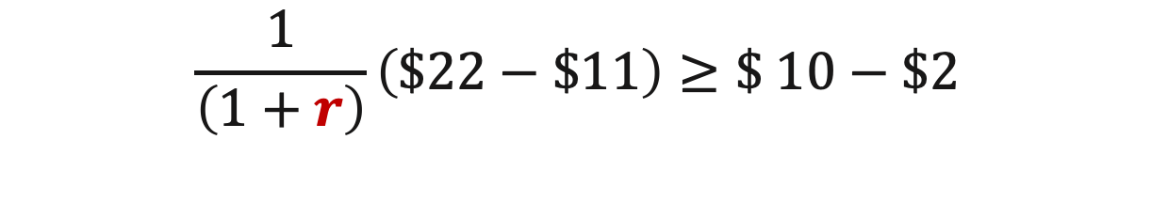
Interest Rate, Discounting and Present Value

Slide 124
Interest Rate, Discounting and Present Value
Future benefit: $11

Slide 125
Interest Rate, Discounting and Present Value
Future benefit: $11
Today’s cost: $8

Slide 126

Interest Rate, Discounting and Present Value

Slide 127
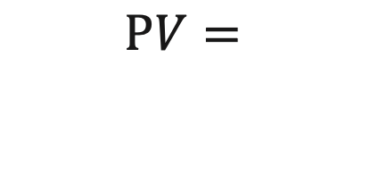
Interest Rate, Discounting and Present Value
Investment pays $x every period, forever, starting next period

Slide 128
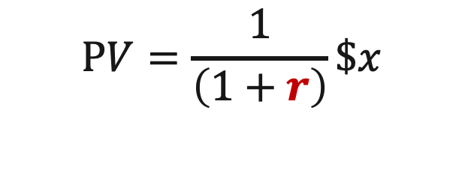
Interest Rate, Discounting and Present Value
Investment pays $x every period, forever, starting next period

Slide 129
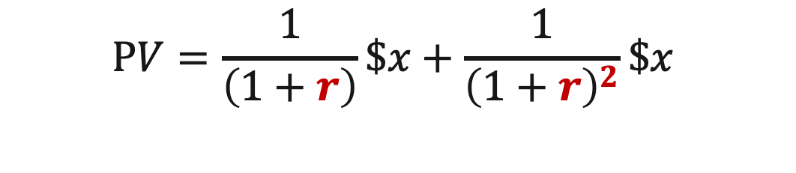
Interest Rate, Discounting and Present Value
Investment pays $x every period, forever, starting next period

Slide 130
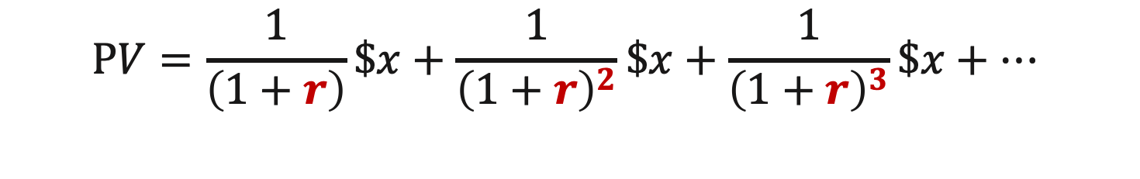
Interest Rate, Discounting and Present Value
Investment pays $x every period, forever, starting next period

Slide 131
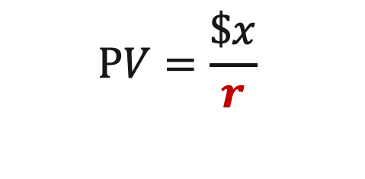
Interest Rate, Discounting and Present Value
Investment pays $x every period, forever, starting next period

Slide 132
Interest Rate, Discounting and Present Value
Investment pays $x every period, forever, starting next period

Slide 133
Question
If interest rates increase, what do you expect to happen to companies whose value is primarily based on future earnings (growth stocks)?

Slide 134
Microeconomics for Business
Chapter 10 – Game Theory Part 2 (Dynamic Games)
Repeated Games

Slide 135
Repeated Games

Slide 136
Repeated Games
In repeated games, there is one game called the stage game that is repeated a certain number of times.

Slide 137
Repeated Games
In repeated games, there is one game called the stage game that is repeated a certain number of times.
At each period (or each round), players play the stage game: they select actions, play the stage game and receive their payoffs according to the outcome implied by their actions.

Slide 138
Repeated Games
Assumption: at the end of each round, players can observe the actions taken by the other players in that round.

Slide 139
Repeated Games
Assumption: at the end of each round, players can observe the actions taken by the other players in that round.
A player's strategy can then be defined as how the player wants to play each round of the stage game, given what happened in all earlier rounds of the game.

Slide 140
Repeated Games
Example: Prisoners' Dilemma game as the stage game
What happens if the players repeatedly play this game a certain number of times?

Slide 141
Repeated Games
Example: Prisoners' Dilemma game as the stage game
What happens if the players repeatedly play this game a certain number of times?
Under certain conditions, players are able to cooperate and help each other in repeated games, even when they would not cooperate if the stage game was only played once.

Slide 142
Repeated Games
Stage Game: Prisoner’s Dilemma
Player 2
 | Cooperate | Don’t Cooperate
Don’t Cooperate | 4 , 1 | 2 , 2
Cooperate | 3 , 3 | 1 , 4
Player 1

Slide 143
Repeated Games
Stage Game: Prisoner’s Dilemma
Player 2
 | Cooperate | Don’t Cooperate
Don’t Cooperate | 4 , 1 | 2 , 2
Cooperate | 3 , 3 | 1 , 4
Player 1

Slide 144
Repeated Games
Stage Game: Prisoner’s Dilemma
Player 2
 | Cooperate | Don’t Cooperate
Don’t Cooperate | 4 , 1 | 2 , 2
Cooperate | 3 , 3 | 1 , 4
Player 1

Slide 145
Repeated Games
Stage Game: Prisoner’s Dilemma
Player 2
 | Cooperate | Don’t Cooperate
Don’t Cooperate | 4 , 1 | 2 , 2
Cooperate | 3 , 3 | 1 , 4
Nash
Equilibrium
Player 1

Slide 146
Repeated Games
Stage Game: Prisoner’s Dilemma
Player 2
 | Cooperate | Don’t Cooperate
Don’t Cooperate | 4 , 1 | 2 , 2
Cooperate | 3 , 3 | 1 , 4
Nash
Equilibrium
Player 1
Better Outcome

Slide 147
Repeated Games
Stage Game: Prisoner’s Dilemma
Cooperation Strategy: at each round of the game, the strategy of each player is to play “cooperate” if no player has played “don't cooperate” in the previous rounds. Otherwise, the player will always play “don't cooperate.”

Slide 148
Repeated Games
Stage Game: Prisoner’s Dilemma
Cooperation is similar to an investment

Slide 149
Repeated Games
Stage Game: Prisoner’s Dilemma
Cooperation is similar to an investment
Cooperation implies a lower payoff today

Slide 150
Repeated Games
Stage Game: Prisoner’s Dilemma
Cooperation is similar to an investment
Cooperation implies a lower payoff today
Cooperation implies a higher payoff in the future

Slide 151
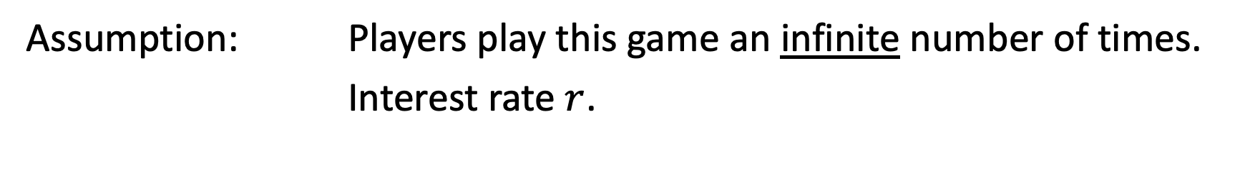
Repeated Games
Stage Game: Prisoner’s Dilemma

Slide 152
Repeated Games
Stage Game: Prisoner’s Dilemma
PV(Cooperate)
PV(Deviate)

Slide 153
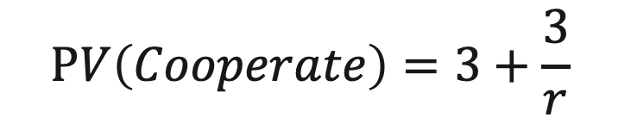
Repeated Games
Stage Game: Prisoner’s Dilemma
Player 2
 | Cooperate | Don’t Cooperate
Don’t Cooperate | 4 , 1 | 2 , 2
Cooperate | 3 , 3 | 1 , 4
Player 1

Slide 154

Repeated Games
Stage Game: Prisoner’s Dilemma
Player 2
 | Cooperate | Don’t Cooperate
Don’t Cooperate | 4 , 1 | 2 , 2
Cooperate | 3 , 3 | 1 , 4
Player 1

Slide 155
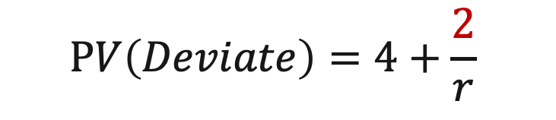
Repeated Games
Stage Game: Prisoner’s Dilemma
Player 2
 | Cooperate | Don’t Cooperate
Don’t Cooperate | 4 , 1 | 2 , 2
Cooperate | 3 , 3 | 1 , 4
Player 1

Slide 156

Repeated Games
Players will be willing to cooperate if

Slide 157


Repeated Games
Players will be willing to cooperate if

Slide 158
Repeated Games
Players will be willing to cooperate if
Future benefit: 1

Slide 159
Repeated Games
Players will be willing to cooperate if
Future benefit: 1
Today’s cost: 1

Slide 160

Repeated Games
Players will be willing to cooperate if

Slide 161
Repeated Games
Stage Game: Prisoner’s Dilemma

Slide 162
Repeated Games
Stage Game: Prisoner’s Dilemma
If players play the stage game only once, then cooperation is not possible.

Slide 163
Repeated Games
Stage Game: Prisoner’s Dilemma
If players play the stage game only once, then cooperation is not possible.
If players play the stage game forever and they are sufficiently patient (interest rate is low), then cooperation is possible.

Slide 164
Repeated Games
Stage Game: Prisoner’s Dilemma
If players play the stage game only once, then cooperation is not possible.
If players play the stage game forever and they are sufficiently patient (interest rate is low), then cooperation is possible.
Players are choosing to follow the cooperation strategy because it is on their best interest to do so, not because someone is forcing them to do so.

Slide 165
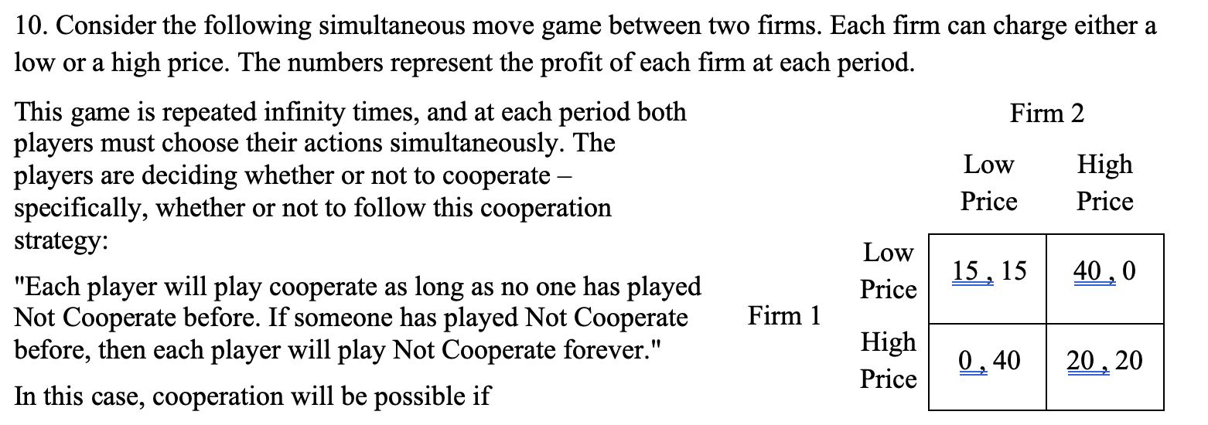

Slide 166
Microeconomics for Business
Chapter 10 – Game Theory Part 2 (Dynamic Games)
Finitely Repeated games

Slide 167
Finitely Repeated Games
Stage Game: Prisoner’s Dilemma
Player 2
 | Cooperate | Don’t Cooperate
Don’t Cooperate | 4 , 1 | 2 , 2
Cooperate | 3 , 3 | 1 , 4
Player 1

Slide 168
Finitely Repeated Games
Stage Game: Prisoner’s Dilemma
Player 2
 | Cooperate | Don’t Cooperate
Don’t Cooperate | 4 , 1 | 2 , 2
Cooperate | 3 , 3 | 1 , 4
Player 1
If players play this game infinite times and the interest rate is low, then we can sustain an equilibrium in which players choose to cooperate.

Slide 169
Finitely Repeated Games
Stage Game: Prisoner’s Dilemma
Player 2
 | Cooperate | Don’t Cooperate
Don’t Cooperate | 4 , 1 | 2 , 2
Cooperate | 3 , 3 | 1 , 4
Player 1
Suppose that players play this stage game 100 times and the game ends after the last round. Consider some low interest rate.

Slide 170
Finitely Repeated Games
Stage Game: Prisoner’s Dilemma
Player 2
 | Cooperate | Don’t Cooperate
Don’t Cooperate | 4 , 1 | 2 , 2
Cooperate | 3 , 3 | 1 , 4
Player 1
Suppose that players play this stage game 100 times and the game ends after the last round. Consider some low interest rate.
How many times will the players play cooperate?

Slide 171
Finitely Repeated Games
Stage Game: Prisoner’s Dilemma
Player 2
 | Cooperate | Don’t Cooperate
Don’t Cooperate | 4 , 1 | 2 , 2
Cooperate | 3 , 3 | 1 , 4
Player 1
Suppose that players play this stage game 100 times and the game ends after the last round. Consider some low interest rate.
Zero times!
How many times will the players play cooperate?

Slide 172
Finitely Repeated Games
Play the stage game 100 times
Backward induction:
Period 100: Both players choose Don’t Cooperate

Slide 173
Finitely Repeated Games
Play the stage game 100 times
Backward induction:
Period 100: Both players choose Don’t Cooperate
Period 99: Both players choose Don’t Cooperate

Slide 174
Finitely Repeated Games
Play the stage game 100 times
Backward induction:
Period 100: Both players choose Don’t Cooperate
Period 99: Both players choose Don’t Cooperate
Period 1: Both players choose Don’t Cooperate

Slide 175
Finitely Repeated Games
Paradox?

Slide 176
Finitely Repeated Games
Paradox?
Game Theory: in repeated Prisoner's Dilemma games, cooperation is only possible when players play the game an infinite number of times and they are sufficiently patient (interest rate is low).

Slide 177
Finitely Repeated Games
Paradox?
Game Theory: in repeated Prisoner's Dilemma games, cooperation is only possible when players play the game an infinite number of times and they are sufficiently patient (interest rate is low).
Real Life: players do not play the game an infinite number of times, but we do observe cooperation in situations that resemble Prisoner's Dilemma games.

Slide 178
Finitely Repeated Games
A key point in the unraveling result is that players know exactly when the game is going to end.

Slide 179
Finitely Repeated Games
A key point in the unraveling result is that players know exactly when the game is going to end.
Assumption: players know that the game will end at some point, but they do not know when.

Slide 180
Finitely Repeated Games
At each round, players choose whether to cooperate.

Slide 181
Finitely Repeated Games
game ends
(future cooperation is not possible)
probability
At each round, players choose whether to cooperate.

Slide 182
Finitely Repeated Games
game ends
(future cooperation is not possible)
probability
At each round, players choose whether to cooperate.
game continues
(future cooperation is possible)
probability

Slide 183
Finitely Repeated Games
Game is played forever and players discount the future

Slide 184
Finitely Repeated Games
Game is played forever and players discount the future
Game will eventually end,
but players do not know when

Slide 185
Finitely Repeated Games
Game is played forever and players discount the future
A low interest rate means that players are patient
(care more about the future)
Game will eventually end,
but players do not know when

Slide 186
Finitely Repeated Games
Game is played forever and players discount the future
A low interest rate means that players are patient
(care more about the future)
Game will eventually end,
but players do not know when
A higher probability that the game will continue means that players are wary of defecting

Slide 187
Sounds boring, but this is life
Life is a finite game that you don’t know when it is going to end.
So, life is a repeated game characterized by interactions with others (likely to recur).
Cooperation is most likely to happen when people value the future and will see each other again

Slide 188
Further
Countries with more future orientation are richer
And countries with more interactions (trade) are also richer

Slide 189
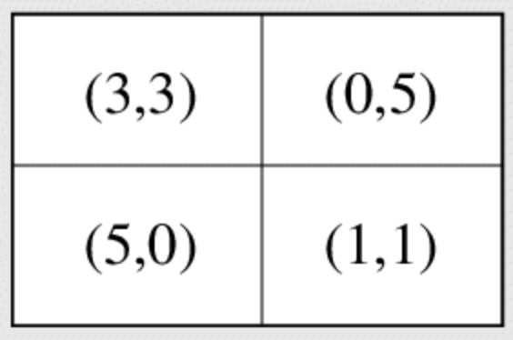
What is your strategy?
Imagine you are playing in a prisoner’s dilemma tournament. What would be your strategy?
1
2
1
2

Slide 190
Tit for Tat
Start with cooperation
Play what the opponent played last round
  Note: if the opponent defects, tit-for-tat immediately defects
  But this only lasts one turn

Slide 191
According to Game theory, the best strategy (in life) is Tit for Tat
Start with cooperation (Be Nice and willing to sacrifice)
Play what the opponent played last round (Clear)
  Note: if the opponent defects, tit-for-tat immediately defects (don’t be a pushover)
  But this only lasts one turn (forgive)

Slide 192


